Slide 1
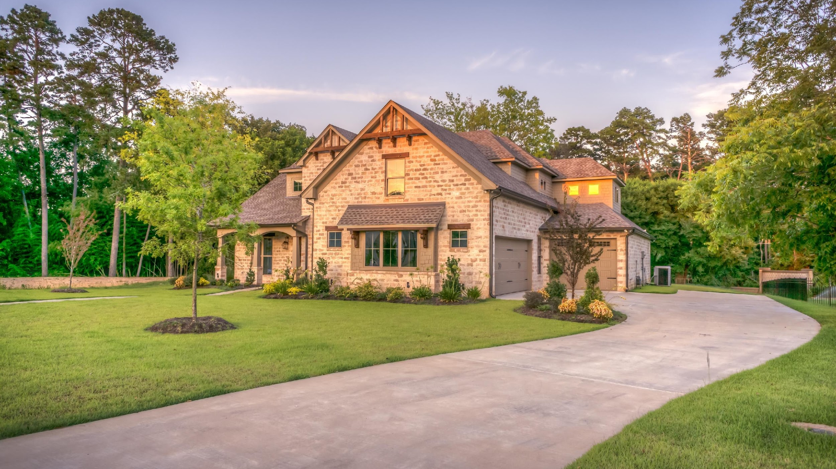
The Effect of Housing Features on Sale Price
National Association of REALTORs Conference - March 20, 2023
Rob Golder
Brought to you by: https://GoogleSlidesThemes.com

Slide 2

Ames, Iowa
Go Cyclones!!!
30 miles from Des Moines
Population: 66,427
(about 28k students)
Median age: 23.8
Avg. House Price (2023): $245,672
Sources: Wikipedia, Zillow.com

Slide 3
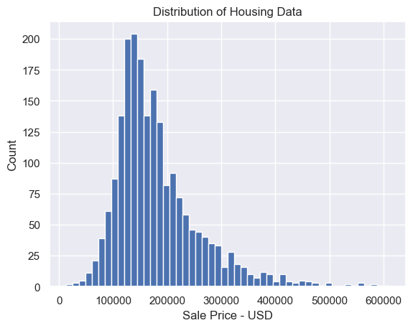
Distribution of Sale Prices

Slide 4
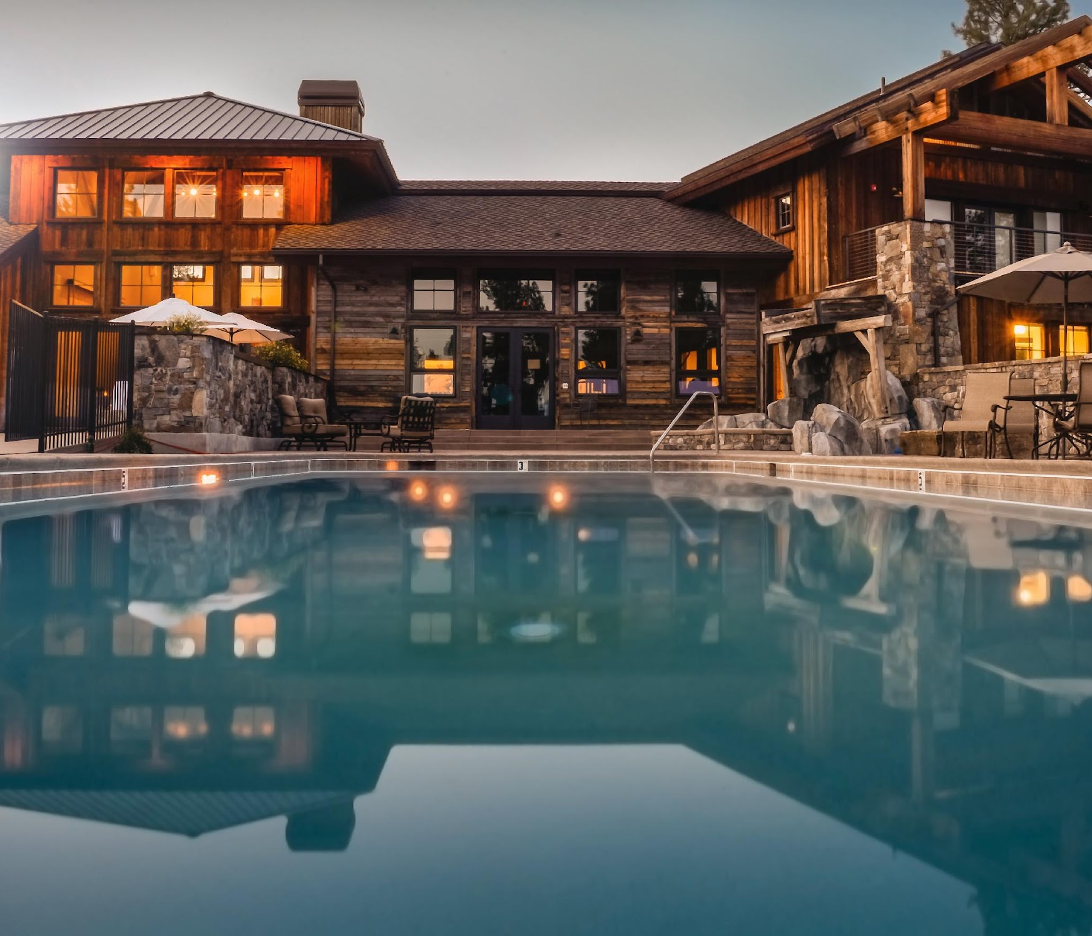
Most Significant Factors
Total Rooms (above ground): $12,000
Exterior Quality: $11,000
Northridge Heights: $10,800
Full Bathroom: $8400
215 sq ft of Garage Area : $8300
Kitchen Quality: $8200
Fireplaces: $7600
Location: Northridge - $7500

